Slide 1
North Boone Community Unit School District 200
2022-2023 Budget Overview and 2022 Levy Information
November 3, 2022
Presented by:
Dr. Michael Zelek, Interim Business Manager/CSBO

Slide 6
Levy Adoption Timeline
2022 Levy
November 3, 2022 Review Levy and Timeline with the Board of Education’s Finance Committee
November 15, 2022 Recommendation to the Board of Education to Adopt a Resolution
of Intent to Levy taxes and establish a Hearing Date and Location (at least 20 days prior to adoption)
December 2, 2022 Publish Hearing and Truth in Taxation Notice (7-14 days prior to hearing)
December 13, 2022 Hold Levy and Truth in Taxation Hearing and Adoption of Levy by the Board of Education
December 16, 2022 File Levy with County Clerk and Publish Notice of Levy Adoption

Slide 7
2022 Levy Recommendation
The recommendation is to increase the levy in order to continue to provide the curricular and co-curricular programs offered to students
Abatement #2 in the amount of $200,000.00 will not be included in the recommendation and only use Abatement #1 in the amount of $2,250,000.00 keeping the Tax Rate at 6.8755% (this is the same overall rate previously presented)
Existing property in D200 is anticipated to increase by 4.40% and about $2.5 million in new construction
D200 is requesting a 7.79% increase to provide flexibility between funds anticipating it will receive only a 6.08% increase, including Bonds, with a CPI of 5.00%

Slide 8
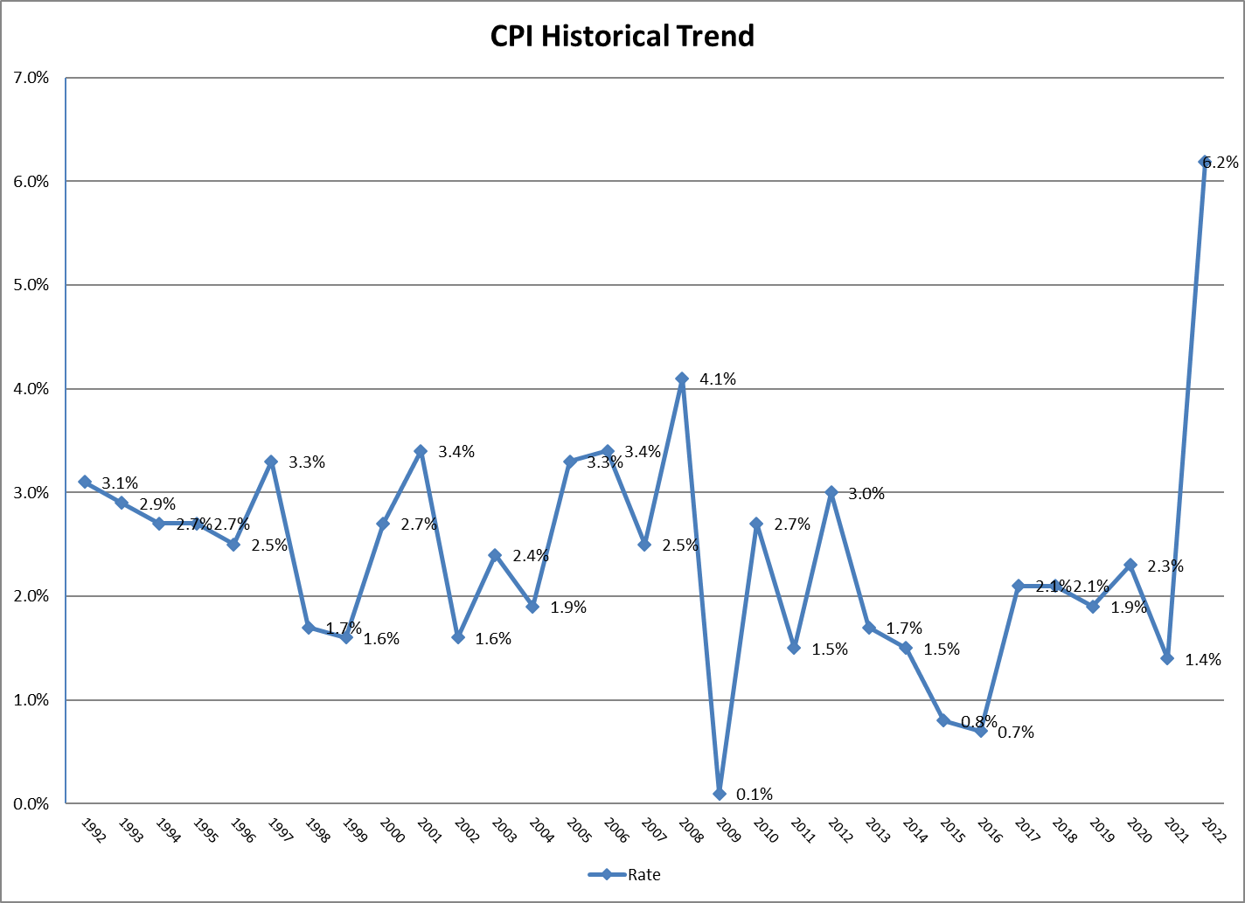

Slide 10
Recommended Levy minus $200,000 Abatement

Slide 11
Recommended Levy minus $200,000 Abatement

Slide 13
Questions?

